Slide 1
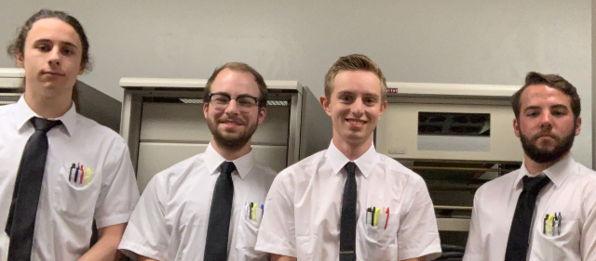
Nasa mission control: day 1
Squad leaders: EVAN
Co-captain: corey
Notes:
Do all of the introductions and round robins here

Slide 2
Mission details
DEADLINE: 4 HOURS
DEBRIEFINGS: INTERMITTENTLY THROUGHOUT THE DAY
POLICIES: NO ENGINEER LEFT BEHIND
MATERIALS: RASPBERRY PI, ELECTRONICS KIT, WITS, AND DETERMINATION
https://www.youtube.com/watch?v=Y8Tko2YC5hA
OBJECTIVE: PROGRAM A MAD LIBS AND A DECISION GAME

Slide 3



WHAT IS A RASPBERRY PI?
MICROPROCESSOR
LINUX OPERATING SYSTEM
RASPBIAN DISK IMAGE
SINGLE-BOARD PC
KEYBOARD AND MONITOR HOOKUPS

Slide 4
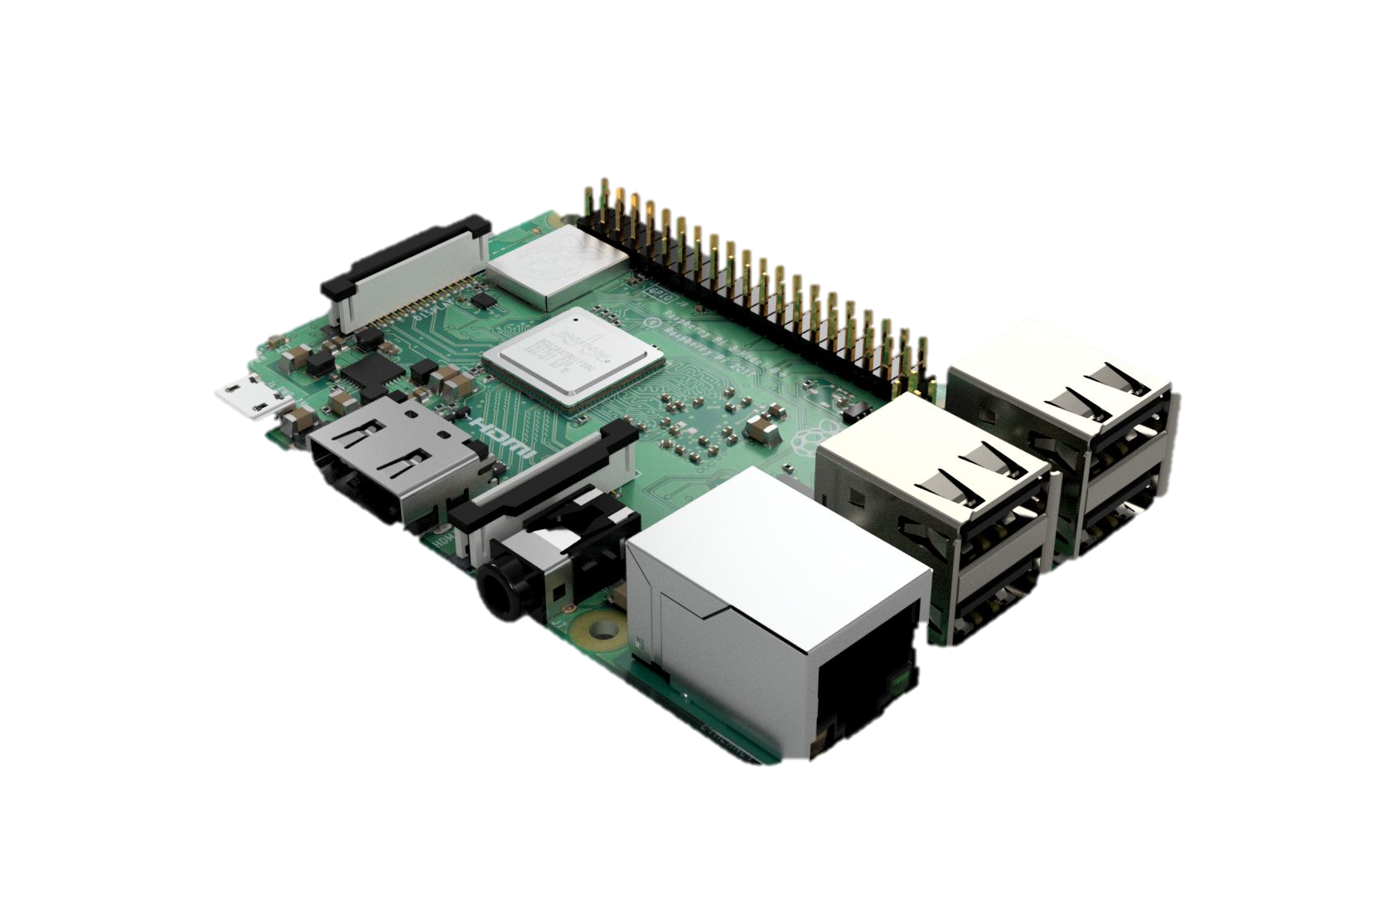
Setting up your pi
Notes:
Go through the kits and help them setup the Pis. They should go through the initialization process.

Slide 5
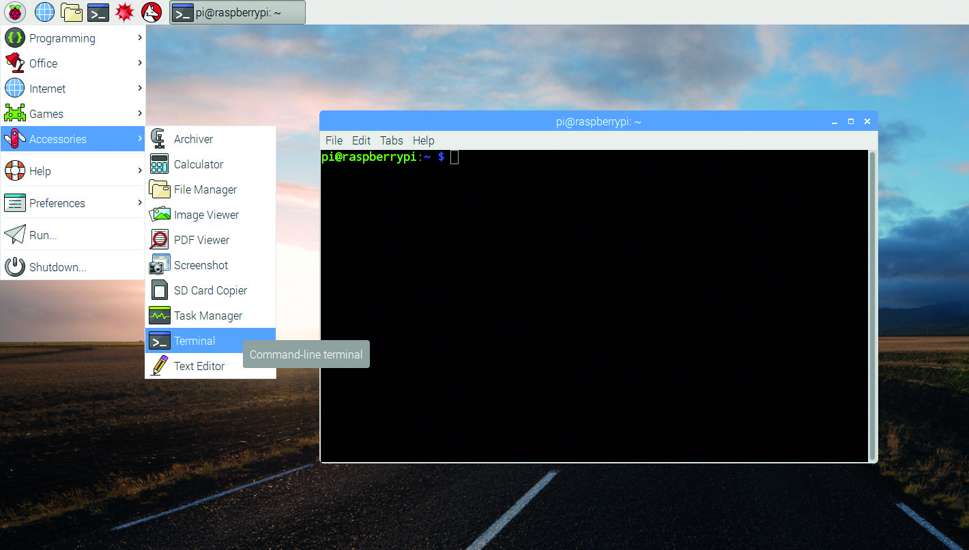
Commanding your pi
OPEN A COMMAND TERMINAL
Ctrl + Alt + T
MAKE YOUR OWN FOLDER
cd /home/pi/Documents
mkdir Week2_PM_YOUR_TEAM
CHECK PYTHON VERSION
python --version
OTHER USEFUL COMMANDS
pwd : PRINTED WORKING DIRECTORY
ls : LIST
man : MANUAL
rmdir : REMOVE DIRECTORY

Slide 6

URL: KAHOOT.IT
Notes:
Day 1: Employee Survey

Slide 7

PYTHON IDLE
NAVIGATE TO YOUR TEAM DIRECTORY (cd)
CREATE A “Day1” FOLDER (mkdir)
LAUNCH IDLE WITH FILENAME
idle3 HelloWorld.py
CREATE HELLO WORLD PROGRAM
ASSIGNING VARIABLES
DATA TYPES
PRINT STATEMENTS
CONCATENATING STRINGS
IF-STATEMENTS
Notes:
Make a Hello World Program with them, they can code along with you and answer questions.

Slide 8
Python Games!
Notes:
Do the Madlib game first, give them the handout. Then ask which game they would like to do next.

Slide 9
Getting the python file using sftp
WHAT DOES SFTP STAND FOR?
OPEN A COMMAND TERMINAL
sftp MY_PI’S_IP_ADDRESS
“raspberry”
cd /home/pi/Documents
get Skeleton_Madlib /home/pi/Documents/Week1_AM_YOUR_TEAM
exit
cd /home/pi/Documents/Week1_AM_YOUR_TEAM
idle Skeleton_Madlib

Slide 10
Getting the python file using sftp
WHAT DOES SFTP STAND FOR?
OPEN A COMMAND TERMINAL
sftp MY_PI’S_IP_ADDRESS
“raspberry”
cd /home/pi/Documents
get Skeleton_Gamebook /home/pi/Documents/Week1_AM_YOUR_TEAM
exit
cd /home/pi/Documents/Week1_AM_YOUR_TEAM
idle Skeleton_Gamebook

Slide 11
Getting the python file using sftp
WHAT DOES SFTP STAND FOR?
OPEN A COMMAND TERMINAL
sftp MY_PI’S_IP_ADDRESS
“raspberry”
cd /home/pi/Documents
get Skeleton_MorseCode /home/pi/Documents/Week1_AM_YOUR_TEAM
exit
cd /home/pi/Documents/Week1_AM_YOUR_TEAM
idle Skeleton_MorseCode

Slide 12
URL: KAHOOT.IT
Notes:
Day 1: Post Game Kahoot

